Slide 1
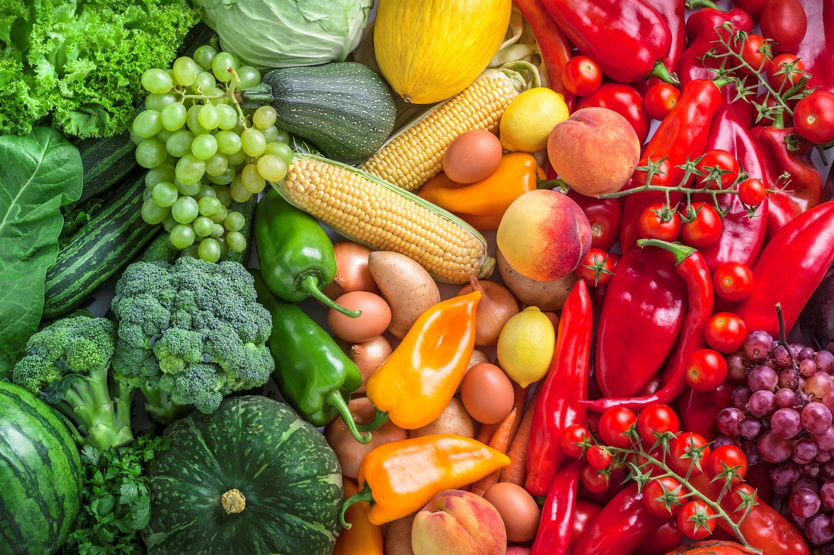

Kisaan Bazaar
:)
Bridging the gap between farmers and potential
buyers

Slide 2
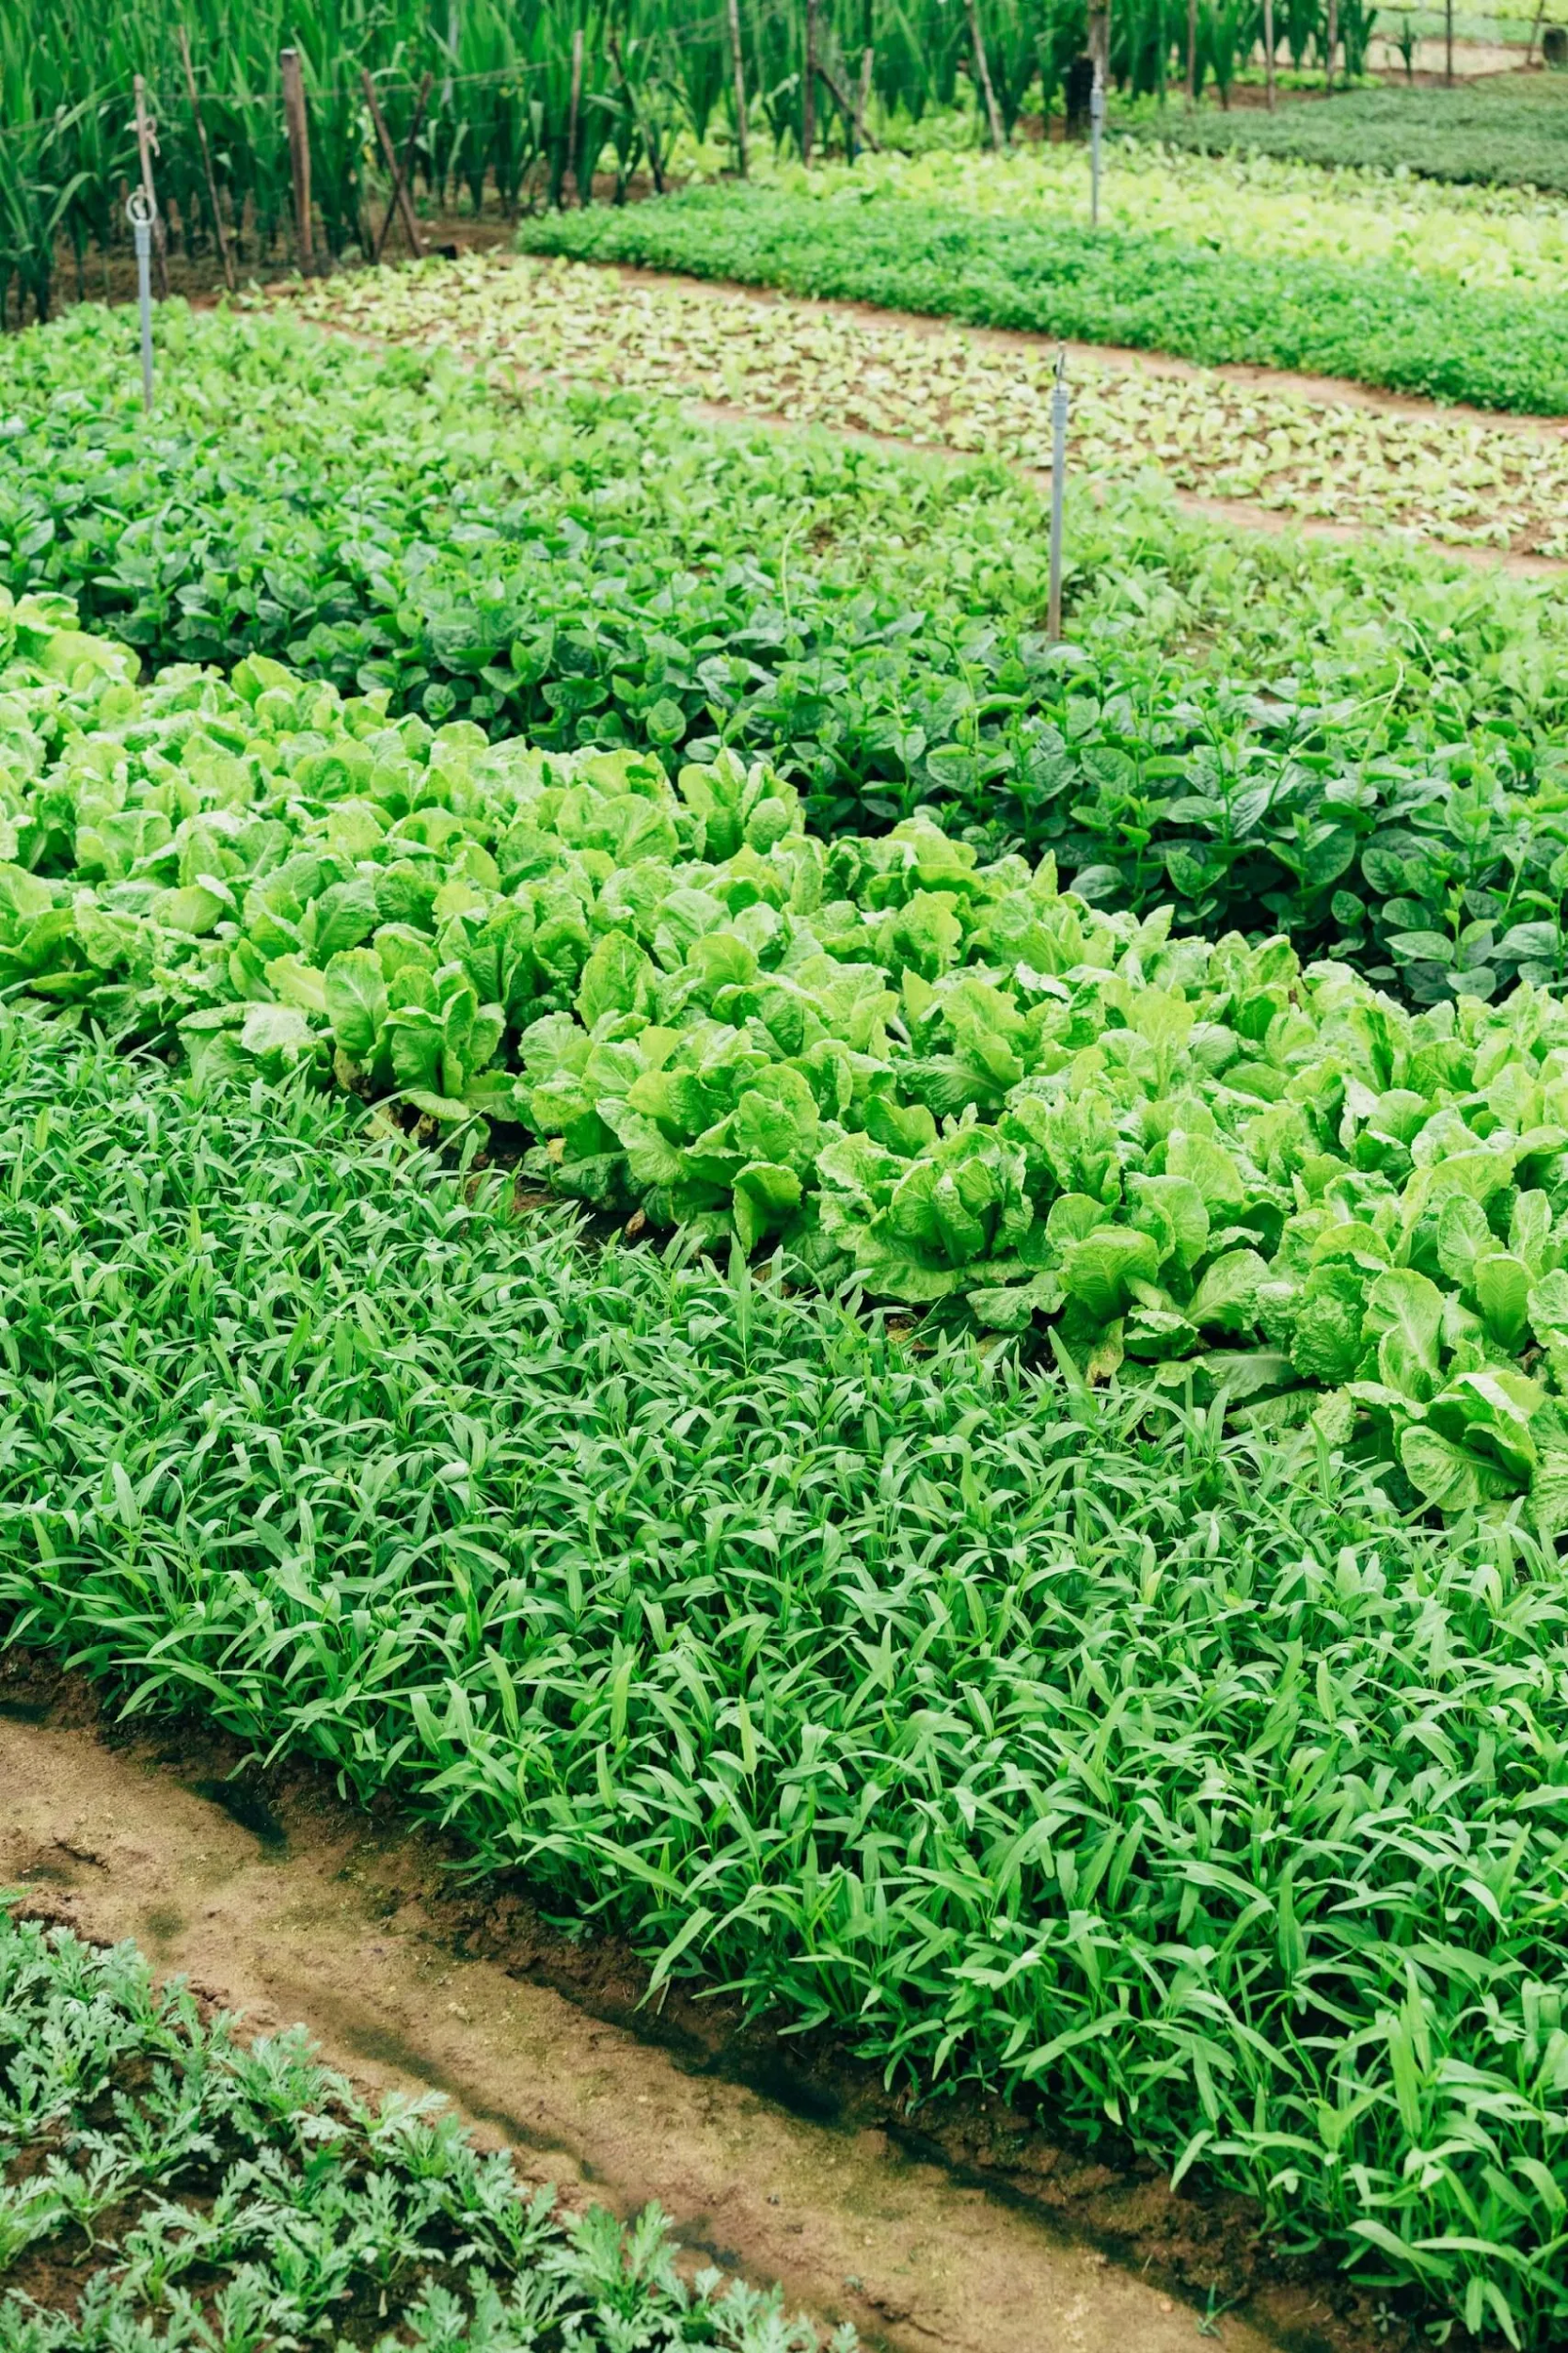
Problems
Farmers are not getting the best price for their crop, not even their MSP defined by the government.
Farmers are forced to sell their crops to the nearest market place available.
Organic/Fresh food items are not available to wholesalers.

Slide 3
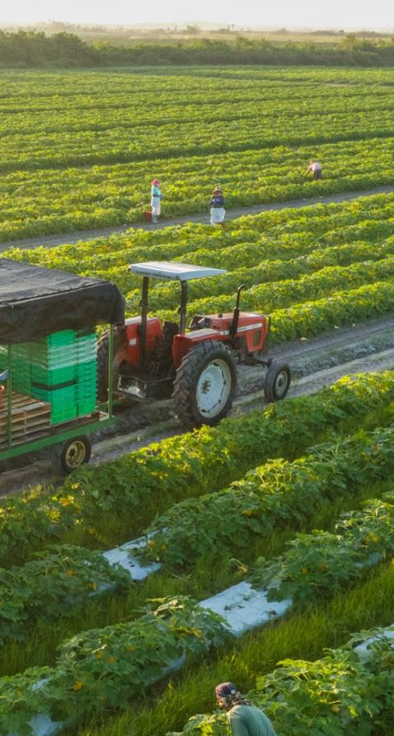
Solutions
We have created an app through which farmer can sell their crops from their MOBILE without needing to go to the market.
Farmers will get better prices for their crops and this might resolve MSP problems that farmers are facing now.
Organic/Fresh food items will be available to wholesalers at a buttons touch.

Slide 4

145,000,000
Market Size
India has over 145 million farmers as of Jan 2020 and the number of retail grocery retailers across India in 2020 amounted to about 12.8 million !!

Slide 5
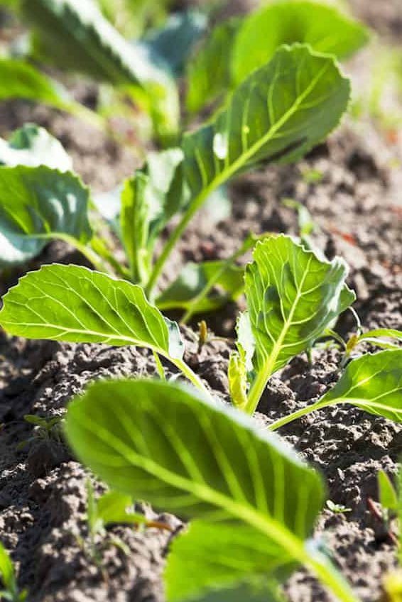
Features
Currently, we will operate only in B2B businesses like Udaan we will sell products only to wholesalers.
All wholesalers need to undergo the KYC process to place orders on our app.
A similar process will be for farmers too.
The delivery charge will be charged to wholesalers.
Wholesalers can rate farmers, if the rating of farmers is under the given standard then we can block farmer’s accounts.

Slide 6


Product Demo
Product Demo
Product Demo

Slide 7
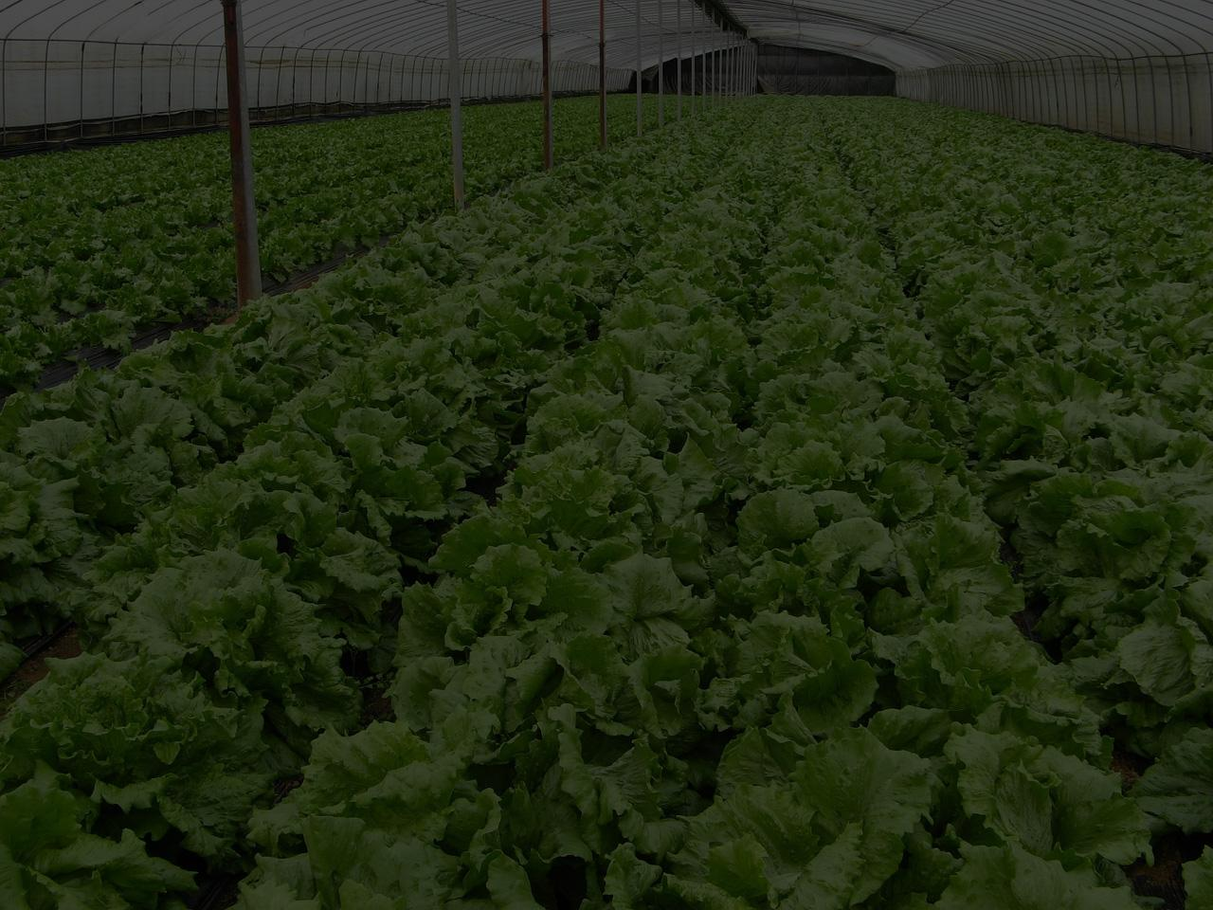
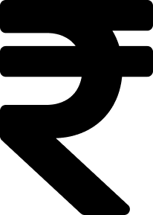


Business Model
Can charge for fast delivery later
Can charge a percentage cut on the order
Can earn by order amount in our bank before sending it to the farmer

Slide 8
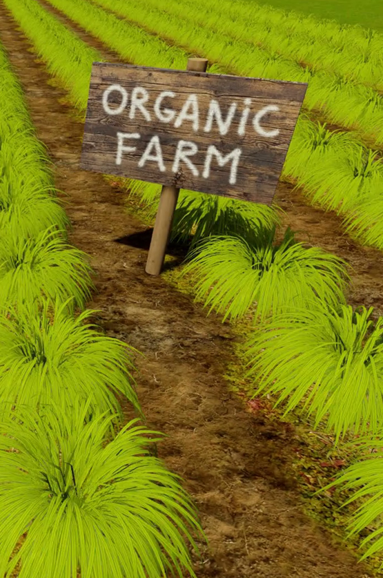
Market Adoption:
We can partner with farmer unions and tell them the benefits of using our app.
We can pitch the wholesaler that here they will get the best quality product at the best price.
Products can be booked beforehand.

Slide 9
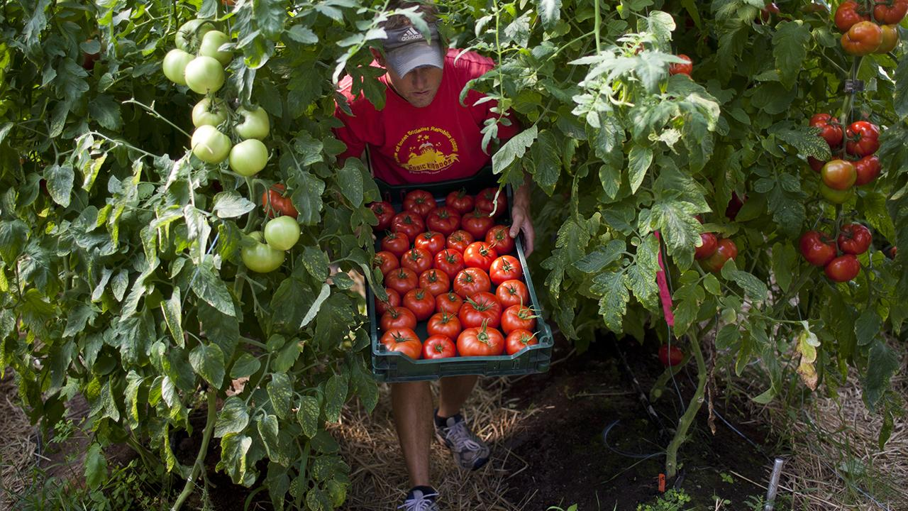
Why Us?
:)
Because we are trying to create a marketplace where there is no middleman.

Slide 10
404 found :(
Competition
Till now no Competitor found who do the exactly same thing as what we are planning to do. So we have a competitive advantage as we are
First in Market
Simple to use
Farmers can sell their crops as well as a wholesaler can buy crops in just 3 clicks

Slide 11

Technology
App built on Android Studio in JAVA.
NoSQL backend used.
Used Node.js, express.js, and firebase.
Deployed APIs on Heroku.

Slide 12
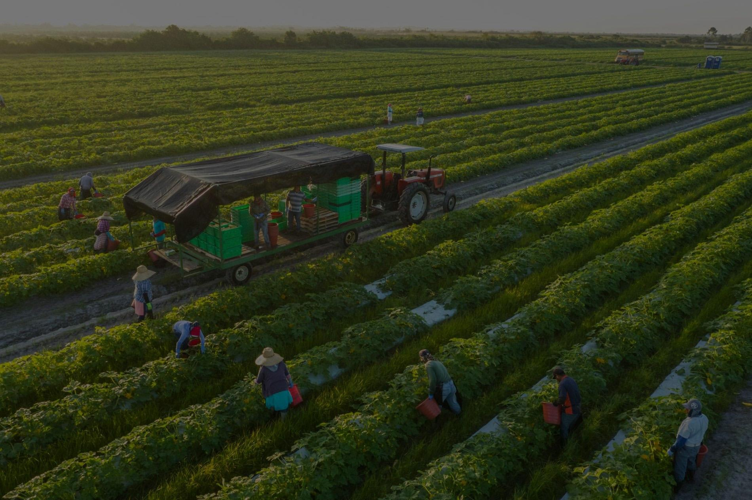
GeekBusters!
Varun Bhardwaj - IIT2019091
Smitesh Hadape - IIT2019090
Varun Tiwari - IIT2019154
Garvit Chittora -IIT2019142
Thanks!

